Slide 1
Predicting the Price of an Airbnb
Sarah Hayes, Sean Lei, Kausik Valeti

Slide 2
What is Airbnb?
Notes:
Sean

Slide 3


Notes:
Sean
What is Airbnb - A global online marketplace and hospitality service. Members can use the service to arrange or offer lodging, primarily homestays, or tourism experiences.
Why you should care - If you need a place to stay you may consider airbnb over a hotel & you can start a side business by renting out your home

Slide 4
Questions We Will Conquer
What are the most important variables that drive Airbnb price?
How can we predict the average nightly cost of an Airbnb unit?
Notes:
Sean

Slide 5
The Data Set
Inside Airbnb
Data scraped from airbnb.com using Python
Information about rental properties
Open Data DC
Metro Locations
Bike Share Locations
Museums
Crimes - Homicide, Arson, Assault
Sex Offender Registry
Notes:
Sarah:
Inside Airbnb data includes

Slide 6
The Data
64 Attributes and more than 8000 rows
id | rev_comm | NearbyAssault | Closest_GunShot
bathrooms | rev_loc | NearbyBikeShare | Closest_Homicide
bedrooms | rev_val | NearbyClassASexOffenders | Closest_ClassA_SexOffender
beds | host_responsetime | NearbyGunShots | AvgNightlyPrice
guests_included | host_response_rate | NearbyHomicide | AvgNightlyAdjusted_price
extra_people | host_is_superhost | NearbyMetros | MinNightlyprice
cancel_pol | host_listings_count | NearbyMuseums | MinNightlyAdjusted_price
room_cat | accommodates | NearbySexCrime | MaxNightlyprice
Family_Friendly | Basic_Amenities | NearbySexOffenders | MaxNightlyAdjusted_price
Pets_Allowed | deluxe_amenities | Closest_BikeShare | square_feet
Smoking_Allowed | Total_Amenities | Closest_Metro | property_type
Events_Allowed | security_deposit | Closest_Museum | len_desc
rev_rating | cleaning_fee | Closest_SexCrime | len_summary
rev_acc | number_of_reviews | Closest_SexOffender | len_rules
rev_clean | reviews_per_month | Closest_Arson | Cost_room
rev_check | NearbyArson | Closest_Assault | Cost_person_incuded
Notes:
Sarah:
Inside Airbnb data includes

Slide 7
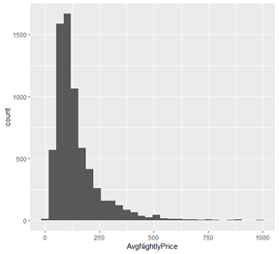
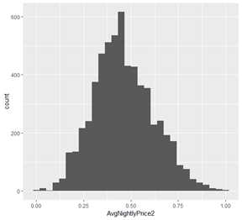
Distribution of Response Variable
Before Transformation
Skewness = 2.76
After Transformation
Skewness = 0.28
Notes:
Sarah

Slide 8
PCA
What is PCA?
Used for Exploratory data analysis.
Used to create predictive models.
Can reduce dimensions to better reduce of data by identifying most influential variables.
PC-1 explains most or highest variance and then followed by PC-2 with second most variance.
Having a discrete variables makes PCA highly significant.
Notes:
Kausik

Slide 9
PCA
From the graph we can say that,
Max,Min,Avg_nightly prices,cleaning_fee,guest_included has negative PC-1 values and has high variance.
No.of reviews, rating, cleaning has positive PC-2 values and nearby homicide has negative PC-2 values.
The prices of the property types are less in positive side of PC-1.
As the number of reviews per month and ratings are more, nearby homicides are less.
Nearbysexoffenders has less influence on PC-1.
Notes:
Kausik

Slide 10
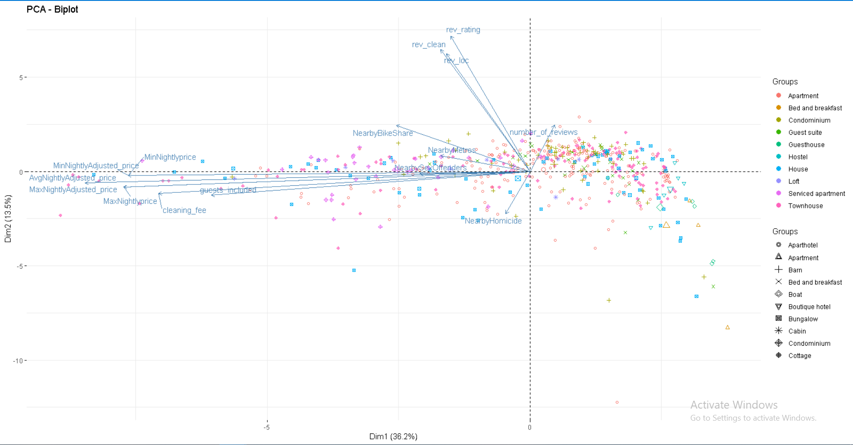
Notes:
Kausik

Slide 11
Methods for Predicting Average Nightly Price
Random Forest Regression
Linear Regression
vs
Notes:
Sean
Objective - to take a poorly designed graph and redesign it by implementing good visualization techniques using R
Article posted by Raul on howmuch.net in 2017
Bad Graph - The article attempts to inform readers about the most and least valuable states in america. This is visually shown by comparing median housing prices and land valuations throughout the U.S.

Slide 12
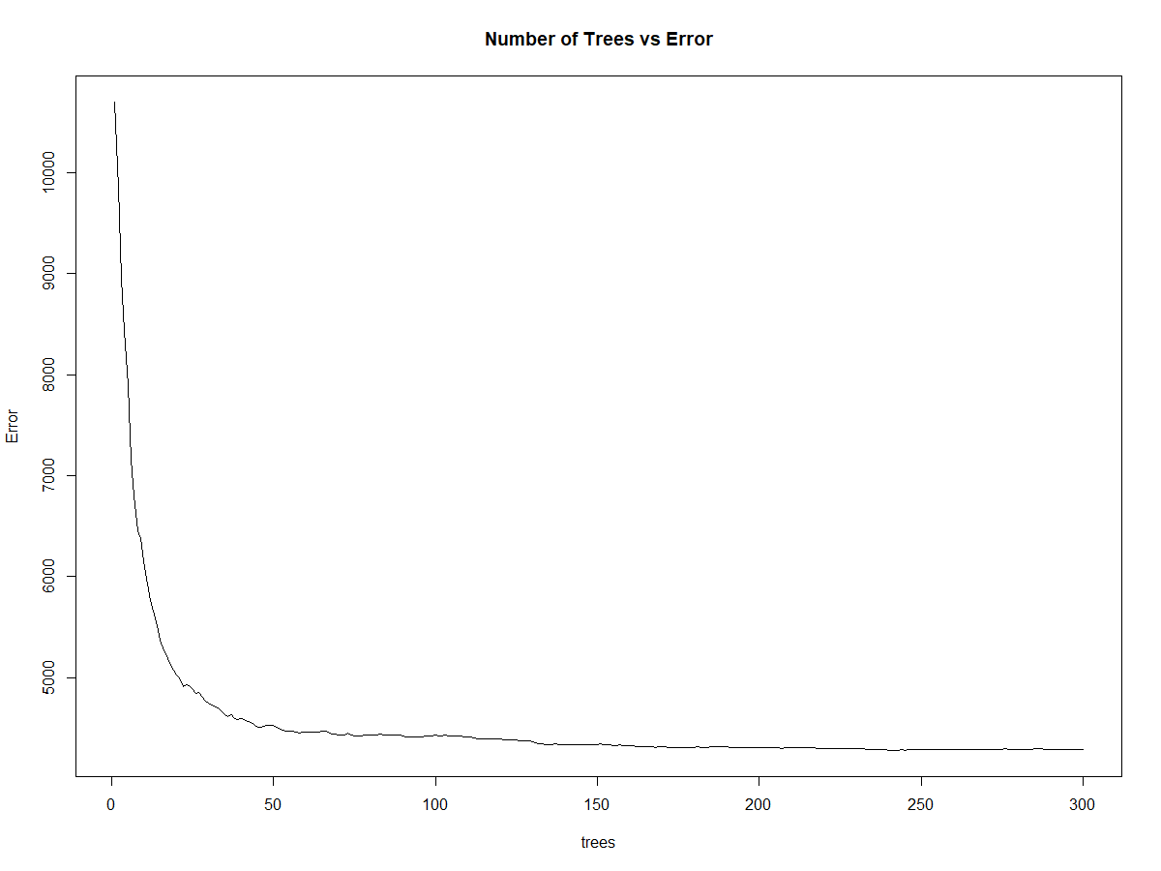
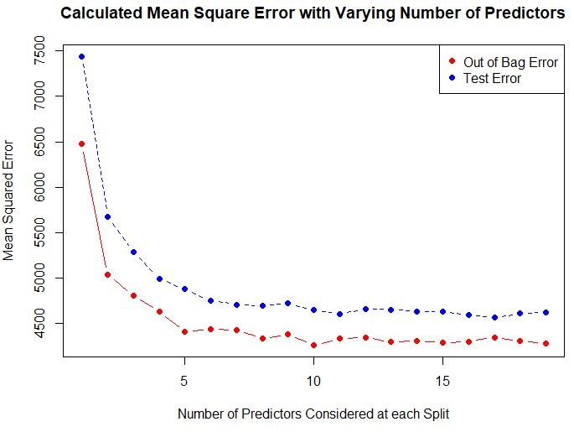
Random Forest For The Win
Number of trees = 200
Number of predictors at each split = 7
Notes:
Sean
MSE vs Trees
MSE vs #Predictors at each split
Out of Bag error is a method of determining the prediction error that allows the Random Forest to be fit and validated during training
To train, RF does bagging to sub-sample data set. Trees are created using each sub-sample
OOB error is the average error for each AvgNightlyPrice calculated using predictions from the trees that did not contain that datapoint in their sub-sample

Slide 13
RF MSE = 4766.409
Root Mean Squared Error = $69.04
Notes:
Sean
Objective - to take a poorly designed graph and redesign it by implementing good visualization techniques using R
Article posted by Raul on howmuch.net in 2017
Bad Graph - The article attempts to inform readers about the most and least valuable states in america. This is visually shown by comparing median housing prices and land valuations throughout the U.S.

Slide 14
Random Forest APE = 26.4% Random Forest RMSPE = 37.0%
Notes:
Sean
Objective - to take a poorly designed graph and redesign it by implementing good visualization techniques using R
Article posted by Raul on howmuch.net in 2017
Bad Graph - The article attempts to inform readers about the most and least valuable states in america. This is visually shown by comparing median housing prices and land valuations throughout the U.S.

Slide 15
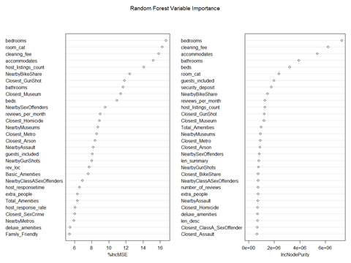
Random Forest Important Variables
bedrooms
room_cat (privacy)
cleaning_fee
accomodates
host_listings_count
Notes:
Sean
Shows how much the MSE would increase is a variable was permuted, or randomly shuffled. The higher the %IncMSE, the more important the variable.
Node 50/50 split is impure and 100% one class is pure
%IncMSE is a more stable representation of variable importance

Slide 16
Linear Regression
Pre-processing
Transformed response variable (square root)
Removed outliers
MinMax Normalization
Split training/test
Fit Model
47 independent variables in initial model
AIC to identify the deviance and perform variable selection
Balance model complexity and fit
Notes:
Sarah

Slide 17
Linear Regression
Variable Description | Coefficient | p | Variable Description | Coefficient | p
Intercept | -0.1437 | 2.16E-13 | Cleanliness Rating-User Review | 0.0915 | 3.12E-09
# Reviews per month | -0.0919 | 2.07E-15 | # of Basic Amenities (pool, etc.) | 0.0919 | 1.24E-15
Distance from nearest arson | -0.0504 | 2.55E-07 | # of bathrooms | 0.0923 | 1.26E-03
# of Assaults within 0.5 miles | -0.0483 | 5.16E-06 | Distance from nearest gunshot | 0.1012 | 4.19E-13
Flexible cancellation policy | 0.0093 | 1.50E-02 | Location Rating-User Review | 0.1049 | 5.81E-11
Hosted by “Super Host” | 0.0124 | 3.49E-04 | Capacity (max # of guests) | 0.1572 | 2.00E-16
Designated Suitable for Families | 0.0165 | 5.25E-07 | Cleaning Fee | 0.1692 | 2.00E-16
# of Museums within 0.5 miles | 0.0542 | 1.03E-04 | # of Bike Shares within 0.5 miles | 0.1822 | 2.00E-16
# of Basic Amenities (A/C, etc.) | 0.0557 | 1.91E-09 | Property Category | 0.2223 | 2.00E-16
Distance from nearest sex offender | 0.0593 | 3.38E-04 | # of bedrooms | 0.3321 | 2.00E-16
Linear Regression APE = 29.2%
RMSPE=41.9%
Notes:
Sarah

Slide 18
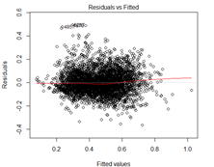
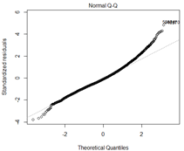
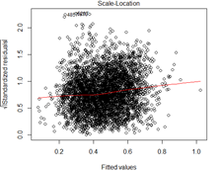
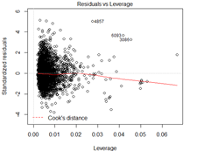
Linear Regression - Diagnostic Plots
Notes:
Sarah

Slide 19
Linear Regression vs Random Forest
Linear Regression APE = 29.2%
Random Forest APE = 26.4%
Linear Regression RMSPE = 41.9%
Random Forest RMSPE = 37.0%
The random forest price prediction outperformed the linear model prediction by
2.8%
*All run on the transformed data
Notes:
Sean
Scrubbed data (high prices removed)

Slide 20
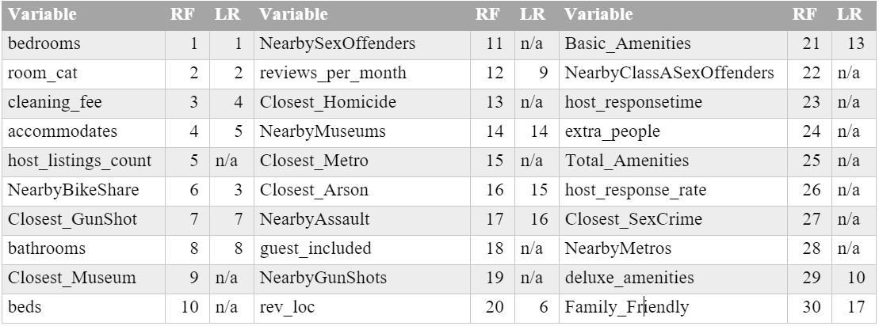
Important Variables
Notes:
Sean
7 of the top 8 variables shared

Slide 21
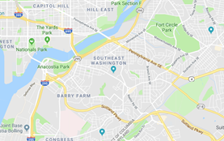
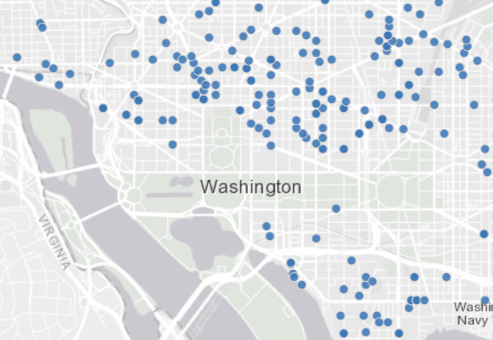
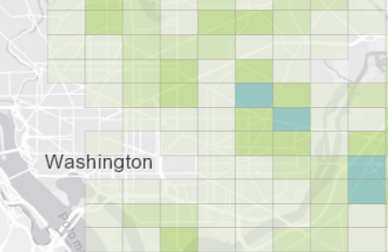
Conclusion
Random forest provides better fit with less pre-processing
Similar variables important in both models
Most important variables aligned with our expectations
Capacity, # of Bedrooms and Bathrooms
Privacy (shared room, private room, whole house)
More Nearby Bike Shares and Fewer nearby Assaults
Positive Reviews
Some surprises
Importance of Nearby Arson
Negative relationship with reviews per month
Positive relationship with nearest gun shot and sex offender
Next steps
Data cleansing
Explore relationships between variables

Slide 22
Questions

